Slide 1


INTRODUCTION
TO
DATA STRUCTURES
IN C++
A Quest Global Company

Slide 2
List of Topics to be covered
Data structures are the fundamental building blocks of computer programming. They define how data is organized, stored, and manipulated within a program.
An array is an example of a data structure, which allows multiple elements to be stored in a single variable.
Below are the topics:
Lists
Stacks
Queues

Slide 3

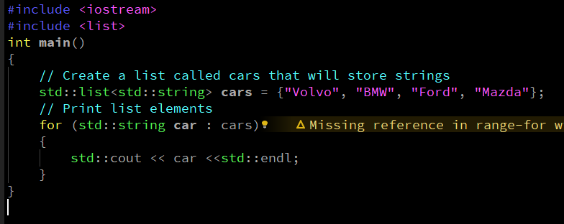
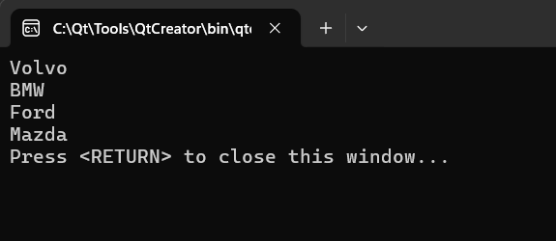
1. Lists
A list is a Data structure it can store multiple elements of the same type and dynamically grow.
we can add and remove elements from both the beginning and at the end of a list.
To create a list, use the list keyword, and specify the type of values it should store within angle brackets <> and
then the name of the list,
Syntax:
Example:-
output:-

Slide 4
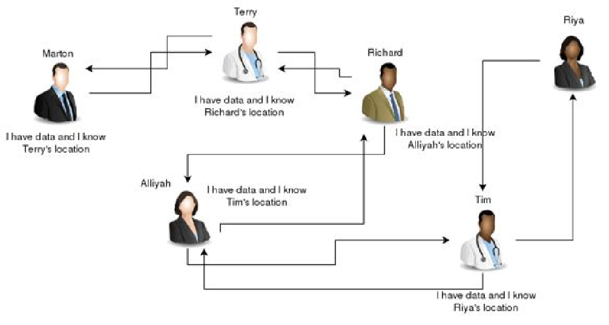
1. Lists
A linked list is a linear collection of data elements, called nodes, where the order of nodes is maintained by explicit pointers, rather than memory location (as in arrays). It is a data structure used to store an ordered collection of elements. These elements can be of the same type and are accessed sequentially or randomly, depending on the list type.
Limitations of Arrays:-
1. Fixed Size
Array Limitation: Once declared, the size of an array cannot be changed.
Linked List Advantage: Can grow or shrink dynamically as needed.
2. Insertion/Deletion
Array Limitation: Inserting or deleting elements (especially in the middle) requires shifting elements.
Linked List Advantage: Insertions and deletions are efficient as only pointers are updated.
3. Memory Wastage
Array Limitation: May lead to wasted memory if the allocated size is not fully used.
Linked List Advantage: Allocates memory only as needed, reducing wastage.
4. Lack of Flexibility
Array Limitation: Requires contiguous memory allocation.
Linked List Advantage: Can utilize fragmented memory efficiently.

Slide 5
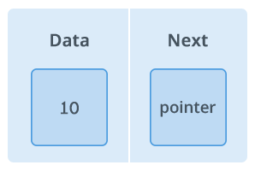
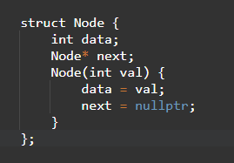
1. Lists
Basic Concepts: Nodes and Pointers
A Node is the basic building block of a linked list.
Each node typically contains:
Data: The value to store (e.g., an integer or string)
Pointer (or next): A reference to the next node in the list
A Pointer is a variable that holds the memory address of another variable.
In linked lists, pointers link one node to the next.
This creates a chain of nodes in memory, even if they aren’t next to each other physically.
Things to Remember about Linked List :-
Head points to the first node of the linked list
Next pointer of the last node is NULL, so if the next current node is NULL, we have reached the end of the linked list

Slide 6
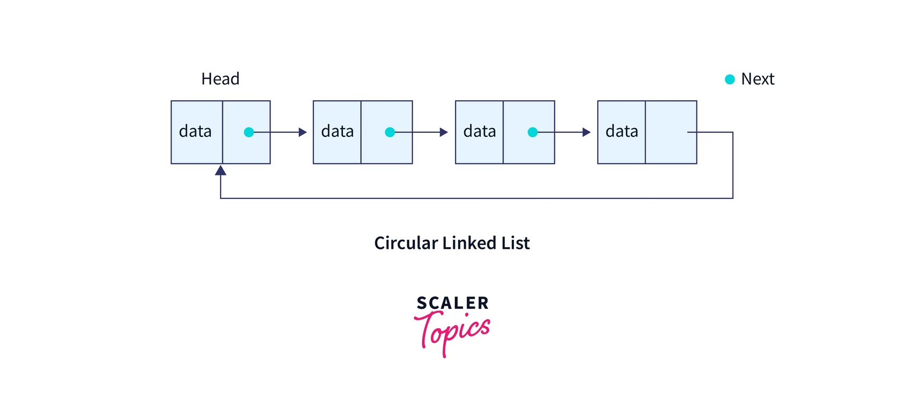
1. Lists
Types of Linked Lists
Single linked list
Doubly Linked List (DLL)
Circular Linked List (CLL)
Single linked list:-
A singly linked list is a type of linear data structure where each element, called a node, contains two parts:
Data: The actual value or information stored in the node.
Next Pointer: A reference (or pointer) to the next node in the sequence.
Unlike arrays, which use contiguous memory locations, linked lists use non-contiguous memory locations for their elements. The nodes are dynamically allocated in memory, and each node points to the next one.

Slide 7
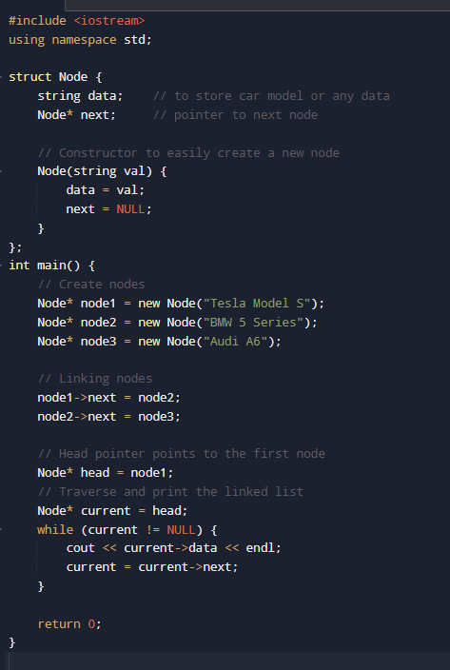
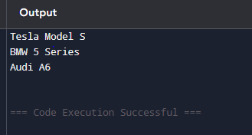
1. Lists
Single linked list
Example:-
output:-

Slide 8
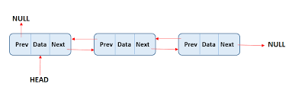
1. Lists
Doubly Linked List (DLL)
A doubly linked list (DLL) is a type of linked list where each node contains three parts:
Data: The value or information the node holds.
Next Pointer: A pointer/reference to the next node in the list.
Previous Pointer: A pointer/reference to the previous node in the list.
This structure allows traversal in both directions (forward and backward) and makes it easier to perform insertion and deletion operations at both ends of the list, or even in the middle.
Circular Linked List (CLL) :-
A Circular Linked List is a type of linked list in which the last node points back to the first node instead of having a NULL reference. This forms a circular chain of nodes.
In a circular list:
The next pointer of the last node points to the head (first node).
In case of a singly circular linked list, traversal is done using the next pointer.
In a doubly circular linked list, each node has an additional prev pointer.

Slide 9
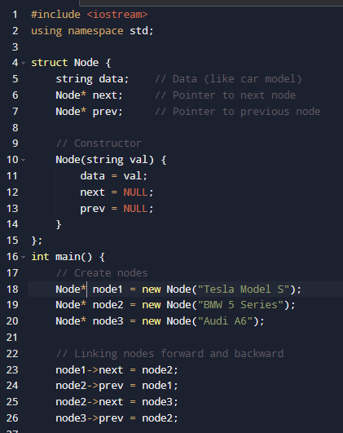
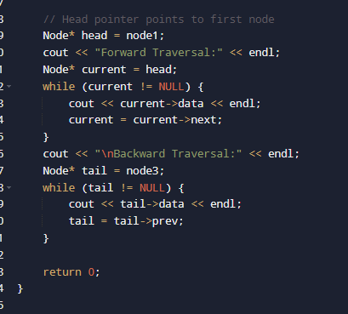
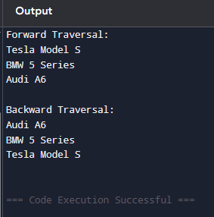
1. Lists
Doubly Linked List (DLL)
Example:-
Part-1
Part-2
output:-

Slide 10
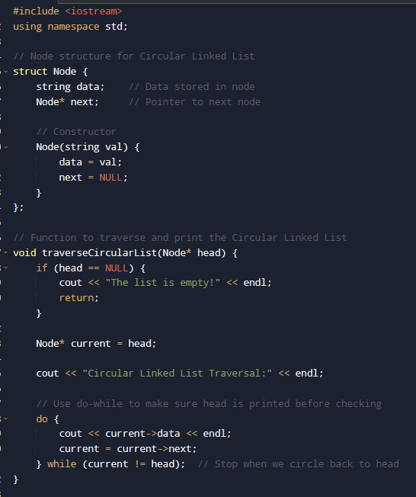
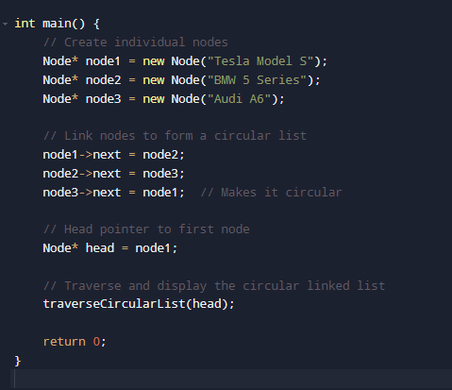
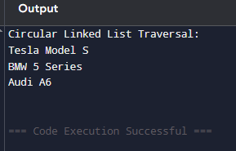
1. Lists
Circularly Linked List​:
Example:-
Part-1
Part-2
output:-

Slide 11



2. Stacks
empty(): The empty() method is used to check whether the stack is empty or not.
Syntax:
Returns true if the stack is empty.
Returns false if the stack is not empty.
size() : The size() method is used to find the number of elements in the stack container.
Syntax:
Returns the number of element present in the stack container.
If there are no elements in the stack, returns 0.
top(): This function is used to reference the top(or the newest) element of the stack.
Syntax:
Returns top of the element in the stack container.

Slide 12
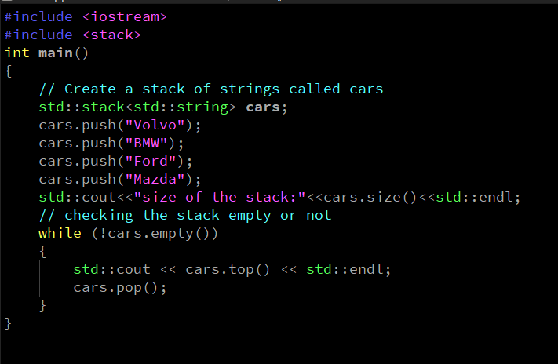
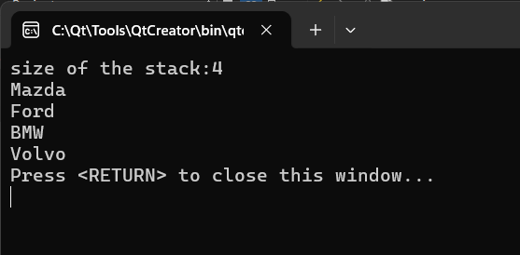
2. Stacks
Example:-
output:-

Slide 13



3. Queues
A Queue stores multiple elements in a specific order, called FIFO.
FIFO, which stands for First In, First Out, queue elements are added at the end and removed from the front, you can only access an element at the front or the back.
To create a queue, use the queue keyword, and specify the type of values it should store within angle brackets <> and then the name of the queue.
Syntax:
Below are the operations performed in stacks:
Push(): The push() function is used to insert an element at the back of the queue. This operation is called push operation hence the name push() method.
Syntax: Here val is parameter value to insert in queue.
Pop(): The pop() this function removes an element from the front of the queue.
It works according to the FIFO (First-In-First-Out) order of deletion. The element that was inserted first will be removed first.
Syntax:

Slide 14




3. Queues
empty(): The empty() function is used to check if the queue container is empty or not.
Syntax:
Returns true if the queue is empty.
Returns false if the queue is not empty.
size() : size() function is used to return the size of the list container which is the number of elements currently stored in the list container
Syntax:
Returns the number of element present in the container.
front(): This function can be used to fetch the first element of a queue.
Syntax:
Direct reference to the first element of the queue container.
back(): This function can be used to fetch the first element from the back of the queue.
Syntax:
Direct reference to the last element of the queue container

Slide 15
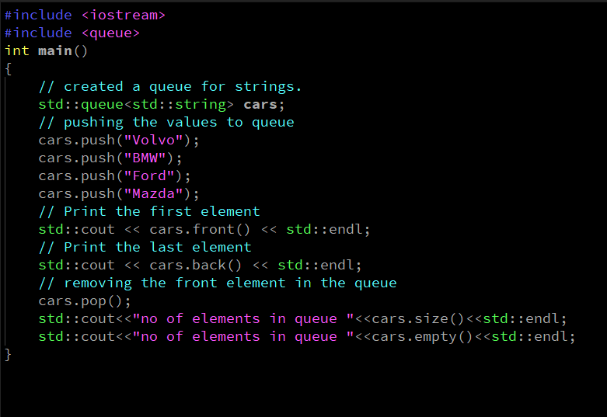
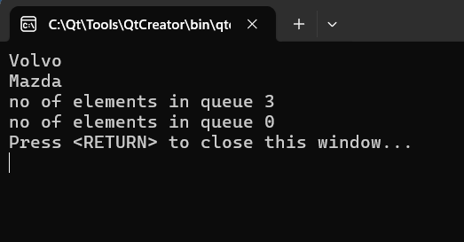
3. Queues
Example:-
output:-

Slide 16


Thank You

